Slide 1
Kinetic Monte Carlo simulations of epitaxial growth of wurtzite GaN(0001)
B.Ravi kumar
110121020
Asia university

Slide 2
Abstract
A lattice based kinetic Monte Carlo (kMC) simulation is developed to describe growth of GaN(0001) in conditions typical of a molecular beam epitaxy unit. Deposition and surface diffusion via attachment and detachment of atoms are the main processes considered in this model.
The energy barriers for surface diffusion are estimated from ab-initio density functional theory calculations. From the ab-initio calculations, we identify a rapid motion of N atoms attached to Ga adatoms. Preliminary kMC simulation results indicate that this motion allows N adatoms to move towards their preferred positions and thereby facilitate smooth growth prior to the formation of the protective Ga adlayer which is believed to promote smooth growth under Ga rich conditions

Slide 3
Introduction
Epitaxial growth of gallium nitride(GaN) is an important step in the fabrication of devices such as light-emitting-diodes [1, 2] and high electron mobility transistors [3, 4]. This fabrication is typically carried out either by metal organic chemical vapor deposition (MOCVD) [5, 6] or by molecular beam epitaxy(MBE) in recent years, the use of plasma sources for nitrogen gas has significantly improved the possibility of MBE for growth of high quality epitaxial GaN films.
In such sources, both nitrogen and gallium are deposited on the surface as atoms, and get incorporated into the crystal without any reactions From the perspective of theoretical modeling, MBE is relatively simpler than MOCVD since there are no reactions, that generate local gradients in composition and temperature.
There is an effective deposition flux of atoms on the growing surface controlled by the effective beam pressures. The atoms on the growing surface undertake several different processes like surface diffusion, evaporation, surface island nucleation and attachment detachment to existing surface features, like steps, or vacancies. Other processes like vacancy formation and diffusion, interdiffusion, etc. also take place but are often neglected in kinetic Monte Carlo simulations.

Slide 4
Model description
In this article, we develop a lattice kinetic Monte Carlo (kMC) simulation of crystal growth of GaN using the popular solid-on-solid (SOS) model of surfaces [12]. Epitaxial growth studies using the SOS model have been widely used for several metallic and semiconductor systems.
In a lattice kMC simulation, the atoms diffuse via hopping across lattice sites with rates that are related to the energy barrier that has to be overcome for this process. However, this rate is highly sensitive to the configuration of the surface. One way to get around this problem is to use a pre-calculated rate catalog consisting of all possible processes and their rates.
Usually the processes are assumed to depend only on the local configuration of the surface, so the number of processes in the rate catalog is finite. The rates for the process can be calculated either using simple models like bond-counting or using sophisticated quantum mechanical calculations. In the case of GaN system, kMC calculations have been performed for growth of zinc blende structure

Slide 5
using a bond counting model [16]. Similarly, kMC with a bond-counting model has been used along with continuum simulations to describe the MOCVD processes for growth of wurtzite GaN [17]. A more sophisticated kMC simulations with input from quantum mechanical calculations using density functional theory has been performed for the GaAs system [18]. The goal of this work is to develop a similar model for growth of wurtzite GaN(0001).
Towards this goal, we first construct the SOS model of GaN and define all the allowed lattice configurations. Then, we identify the optimum deposition sites and hopping barriers using a quantum mechanical calculation using density functional theory (DFT). Finally, we map the deposition sites and barriers back to the SOS lattice and construct the rate catalog which is used in the kMC simulation

Slide 6
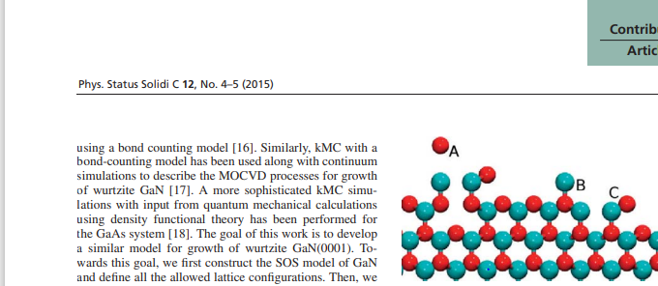
Figure 1 Side view of a typical configuration in the SOS model showing Ga(red) and N(blue) atoms. It is assumed that the crystal is growing in the upward direction. Labels A and B show adatoms of Ga and N, respectively, and label C shows a pair of Ga and N adatoms next to each other

Slide 7
SOS model
We construct a lattice corresponding to the wurtzite structure of GaN, such that the crystal is growing along the (0001) direction (Fig. 1). The Ga and N atoms are filled in their regular lattice positions. We impose the condition that an N(Ga) atom can occupy its regular lattice site only if there is a Ga(N) atom directly below it. This ensures that the deposited atoms will form a solid without vacancies. This simplification also ensures that the atoms cannot form contracted Ga adlayers and bilayers, which are observed in Ga rich conditions.
This can be handled by suitable modifications, but we restrict this article to the simplified model without contracted adlayers and bilayers. Deposition of atoms is implemented by the addition of an atom on top of one of the randomly chosen surface sites. If the site happens to be unsuitable, then the three nearest neighbor sites are examined for suitability, and the atom is moved to one of the suitable sites. If none of the sites are suitable, then the atom is not deposited. These rules indicate that the sticking coefficient of atoms onto the surfaces is 1 for suitable sites. In our algorithm we neglect evaporation of atoms from the surface. It is easy to implement evaporation but we expect it to be less important for MBE growth
SOS model

Slide 8
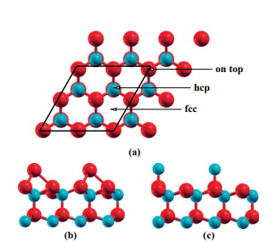
Top view of GaN surface showing various sites for adatoms where the energy is a local minimum. (b) Side view of crystal showing Ga adatom at hcp position (c) Side view showing N adatom at on top position

Slide 9
Conclusions
In this article, we have shown the development of a KMC simulation for studying the growth of homoepitaxial GaN(0001). We have also performed DFT based calculations to determine several barriers that are important for the KMC simulations.
We believe that such calculations can yield significant information about the nature of growth and provide methods to control the morphology. Through ab-initio calculations, we have identified an important process for N-atom motion on the GaN surface which we refer to as the rotation move.
The slow diffusion of N adatoms on GaN surface has been previously reported and the mechanism of adlayer enhanced lateral diffusion has been proposed to explain the smooth growth in Ga-rich conditions
Through these calculations, it appears that there is an additional effect that allows for enhanced diffusion of N atoms. This mechanism may play a role in the early stages of growth before the excess Ga flux which leads to a contracted ad layer. Our preliminary analysis of growth up to 1 ML coverage shows encouraging and broadly consistent results. A detailed analysis and extensions to multilayer growth will be the subject of another article.

Slide 10



Preentation
By
Ravikumar.B

